Slide 1
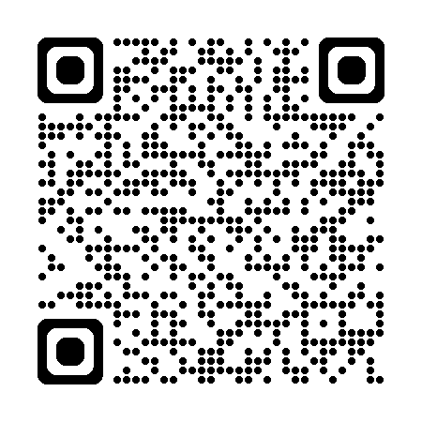
SLSA and
Build Environment Security
A possible version of the future.
Chuck Anderson
info@reliantManagedservices.com

Slide 2
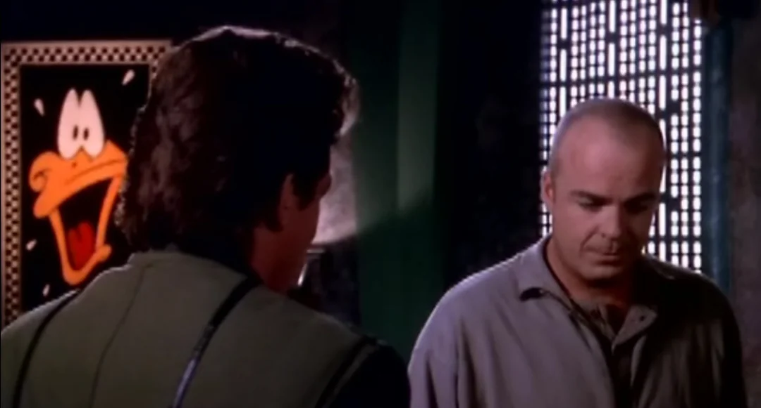
Chuck Anderson - Introduction
Charles “Chuck” Anderson
PMP, CISSP, CSM, ITIL, etc
BS in Cyber, MBA
Recovering… C#, DBA,
+ Solution Builder
All Personal Opinions
No Company Names
Plenty of stories
My spirit animal is also known as
“The ancient Egyptian god of frustration...”
(1994) Michael Garibaldi - Babylon 5
CAVEAT EMPTOR (Lat. “let the buyer beware”), a rule of law that warns the purchaser to take care and examine property before he buys it. -Wikipedia

Slide 3
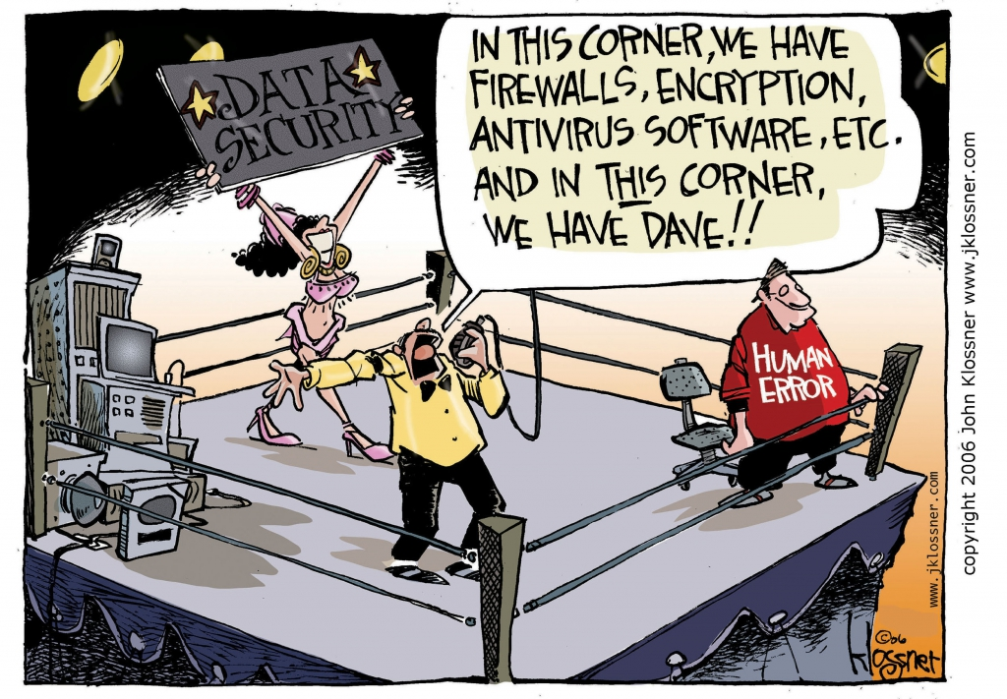
Why are we here?
Sometimes I wonder if teaching sand to think was a bad idea. --Internet

Slide 4
SLSA and Build Environment Security
Intro
Why is Build Environment Security Important?
  SolarWinds
  CVE-2024-3094 “xz BackDoor”
Executive Orders … and the birth of the SBOM
Vocabulary Decision ….
Process Recommendations – Now and Cheap?
Where to start ….. something.yml

Slide 5
SolarWinds -- Attack
CVE-2020-10148: This vulnerability affects the SolarWinds Orion Platform and was exploited by attackers to inject malicious code into the software updates.
CVE-2020-10149: Another vulnerability in the SolarWinds Orion Platform, this CVE was exploited to achieve remote code execution by attackers.
CVE-2020-10150: This CVE is related to an insecure method used by SolarWinds to generate authentication cookies in the Orion Platform, which could allow an attacker to bypass authentication mechanisms.
CVE-2020-10151: An improper input validation vulnerability in SolarWinds Orion API allowed attackers to execute arbitrary SQL queries.
CVE-2020-10152: This CVE is related to the fact that SolarWinds Orion Platform used a hard-coded password for its "solarwinds123" user account, which could be exploited by attackers to gain unauthorized access.

Slide 6
SolarWinds -- Impact
Some reports suggest that approximately 18,000 organizations installed the compromised SolarWinds Orion update(s), which implies a significant number of computers within those organizations were potentially impacted. The affected organizations included government agencies, Fortune 500 companies, technology firms, and other entities using SolarWinds products.
Furthermore, the scope of impact extended beyond the initial compromised networks, as attackers utilized the compromised environments to conduct lateral movement and expand their reach within targeted organizations. This means that even systems not directly exposed to the compromised SolarWinds software might have been affected indirectly.
We will not know the true extent of the impact any time soon.
(50 years is my guess- but I can’t talk about it)

Slide 7
CVE-2024-3094 XZ Backdoor
NVD - CVE-2024-3094 (nist.gov)
Malicious code was discovered in the upstream tarballs of xz, starting with version 5.6.0. Through a series of complex obfuscations, the liblzma build process extracts a prebuilt object file from a disguised test file existing in the source code, which is then used to modify specific functions in the liblzma code. This results in a modified liblzma library that can be used by any software linked against this library, intercepting and modifying the data interaction with this library.
First Published 03/29/2024

Slide 8
CVE-2024-3094 XZ Backdoor
NVD - CVE-2024-3094 (nist.gov)
This social engineering hack took 5 years.

Slide 9
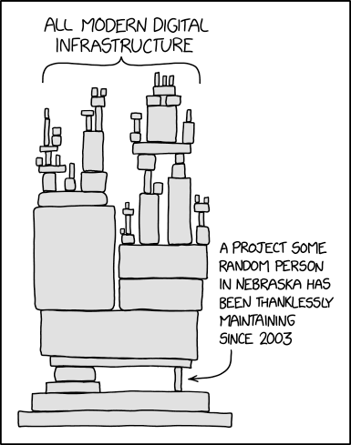
OOPS
H/T: XKCD
CVE-2024-3094 XZ Backdoor

Slide 10
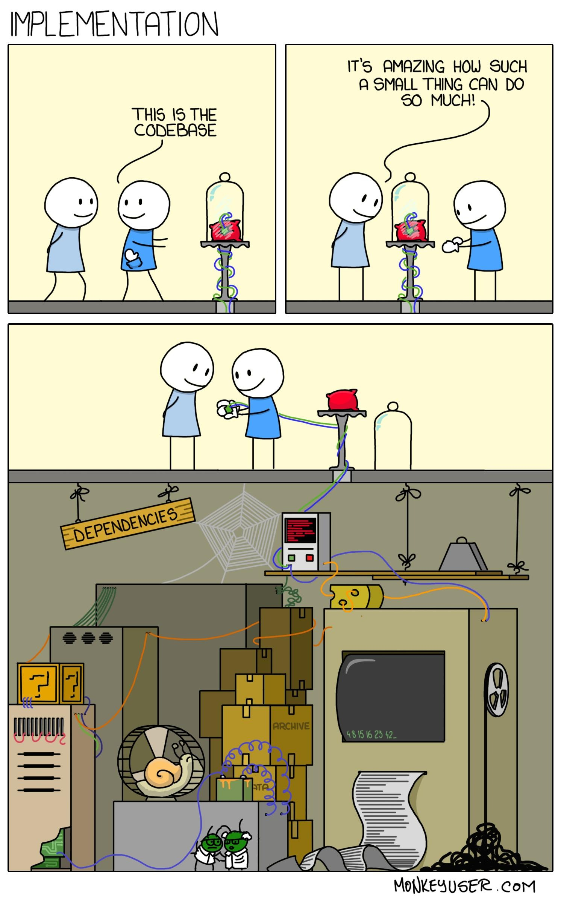
Why are we here?

Slide 11
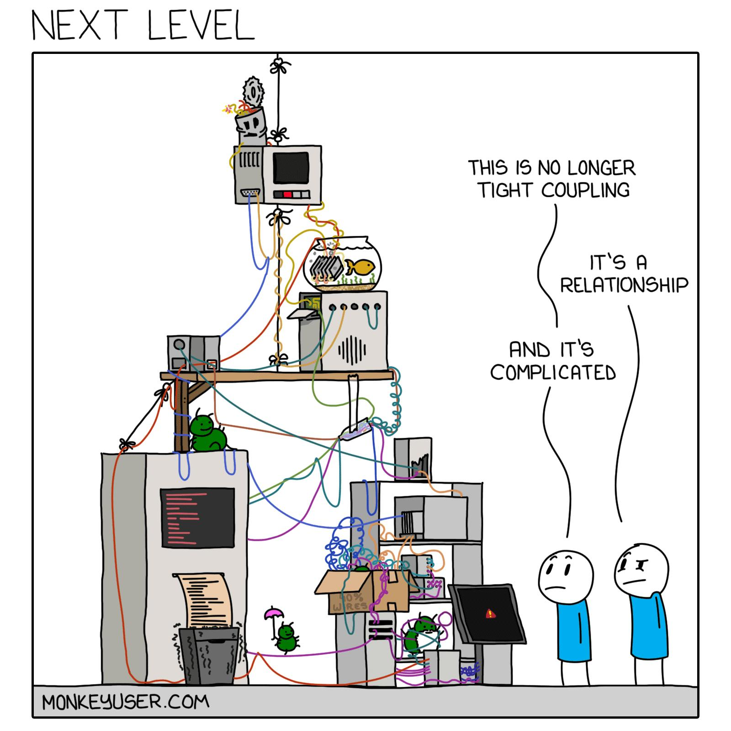
H/T: MonkeyUser.com

Slide 12
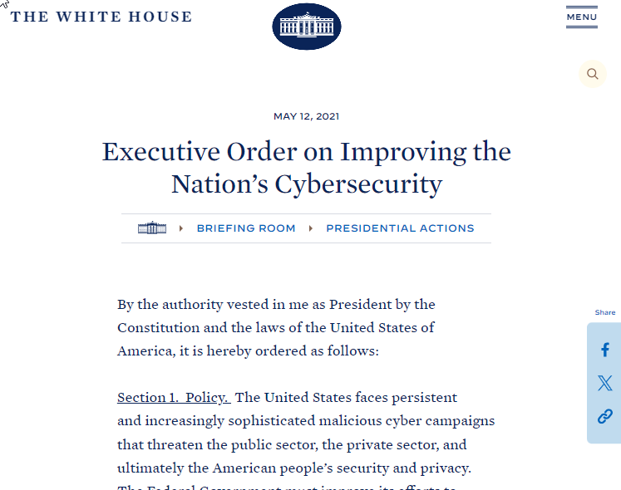
Regulatory Compliance
Executive Order on Improving the Nation's Cybersecurity | The White House

Slide 13
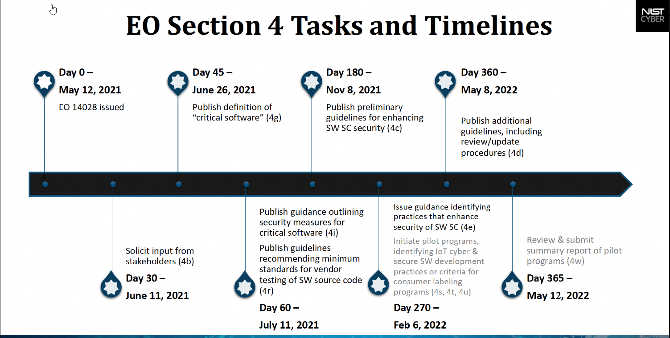

Slide 14
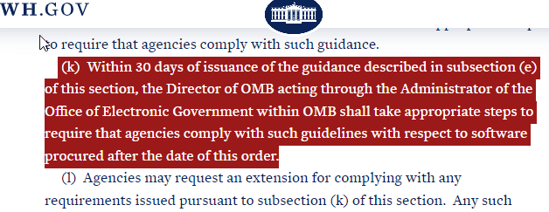
Competitive Advantage
The guidelines shall include criteria that can be used to evaluate software security, include criteria to evaluate the security practices of the developers and suppliers themselves, and identify innovative tools or methods to demonstrate conformance with secure practices.

Slide 15
Definition
Certification -- The process of verifying the correctness of a statement or claim and issuing a certificate as to its correctness
Assessment -- The process of identifying risks
Self Attestation -- The self issuance of a statement, based on a decision, that fulfillment of specified requirements has been demonstrated.
https://csrc.nist.gov/glossary/term/certification
https://csrc.nist.gov/glossary/term/assessment
https://csrc.nist.gov/glossary/term/attestation

Slide 16
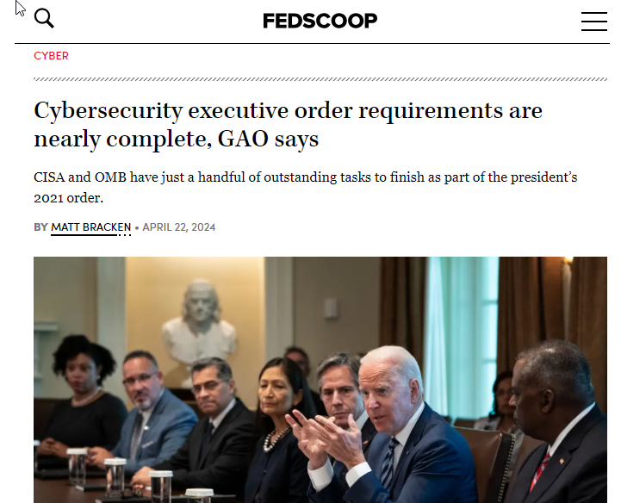
Get Ready
Cybersecurity executive order requirements are nearly complete, GAO says | FedScoop
https://www.gao.gov/products/gao-24-106343

Slide 17
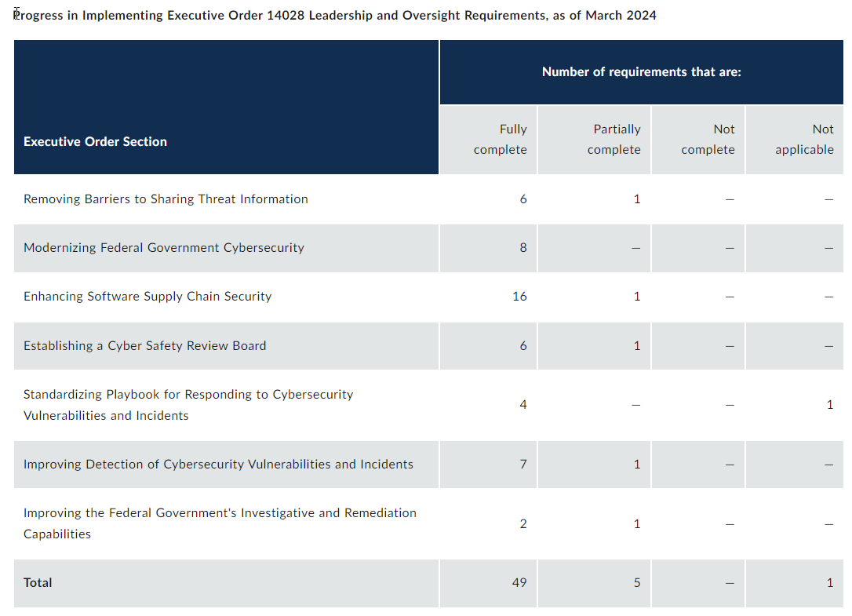
What’s in it!

Slide 18
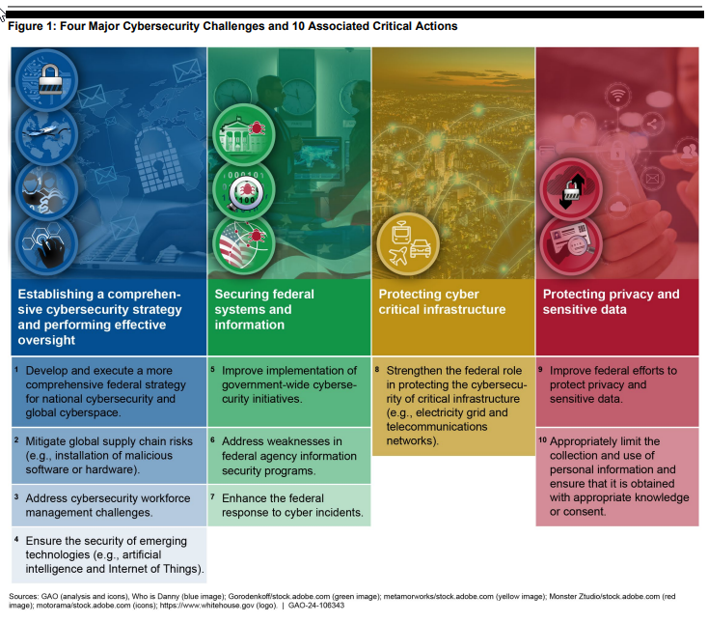
GAO-24-106343, CYBERSECURITY: Implementation of Executive Order Requirements Is Essential to Address Key Actions

Slide 19

Prediction: If you want that government money, You could get nailed….
“The power of the purse.” via GSA Requirements

Slide 20
Gets Better – what about consumers…

Slide 21
Software Labeling
The software cybersecurity labeling provisions in the May 12, 2021, Executive Order on Improving the Nation’s Cybersecurity (14028) aim to aid consumers in their software selection decisions by enabling comparisons among products and educating them about software security considerations. This transparency may also encourage providers to consider cybersecurity aspects of their software and ways to achieve greater consumer trust and confidence in the software, and ultimately, to improve the management of related cybersecurity risks.
Page 23
Recommended Criteria for Cybersecurity Labeling of Consumer Software (nist.gov)

Slide 22
Risk Aversion
A binary label (sometimes called a “seal of approval”) is a single label indicating a product has met a baseline standard. Examples include Energy Star [EPA], USDA Organic [USDA], and the government of Finland’s cybersecurity label [FINLAND]
Page 24
Finland is
Cybersecurity Label | Cybersecurity Label (tietoturvamerkki.fi)
Recommended Criteria for Cybersecurity Labeling of Consumer Software (nist.gov)

Slide 23
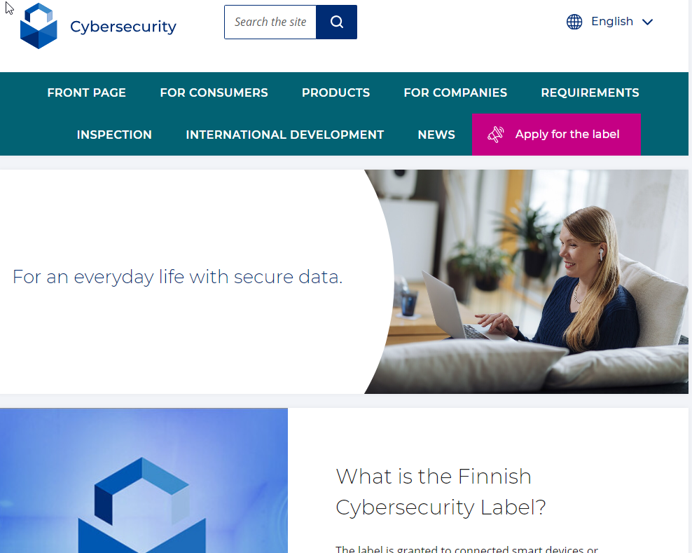
Finland is doing it
Cybersecurity Label | Cybersecurity Label (tietoturvamerkki.fi)
Recommended Criteria for Cybersecurity Labeling of Consumer Software (nist.gov)
“and the government of Finland’s cybersecurity label” Link from Page 26

Slide 24
At a minimum, consumers should have online access – not necessarily included in the label itself – to the following information:
• Intent and scope – What the label means and does not mean
• Product criteria – What cybersecurity properties are included in the baseline and why and how these were selected;
• A glossary of applicable technical terms, written in plain language
• General information about conformity assessment – How cybersecurity properties are evaluated
• Declaration of conformity
• User Data
• Scope
• Changing applicability
• Expectations for consumers – The responsibility consumers share in securing software and how their actions (or inactions) can impact the software’s cybersecurity
• Contact information for the labeling program and information on how consumers can issue a complaint against a vendor regarding a product label
Recommended Criteria for Cybersecurity Labeling of Consumer Software (nist.gov) PG 28

Slide 25
Prediction: If you want that government money, You could get nailed….
Somehow the scope went from “critical” software.. to consumer software labels Between 2021 and 2024

Slide 26
Definition
Certification -- The process of verifying the correctness of a statement or claim and issuing a certificate as to its correctness
Assessment -- The process of identifying risks
Self Attestation -- The self issuance of a statement, based on a decision, that fulfillment of specified requirements has been demonstrated.
https://csrc.nist.gov/glossary/term/certification
https://csrc.nist.gov/glossary/term/assessment
https://csrc.nist.gov/glossary/term/attestation

Slide 27
Risk Aversion
Definition Commentary
Again…
Chuck Anderson’s opinions,
your mileage may and will vary.
Recommended Criteria for Cybersecurity Labeling of Consumer Software (nist.gov)

Slide 28
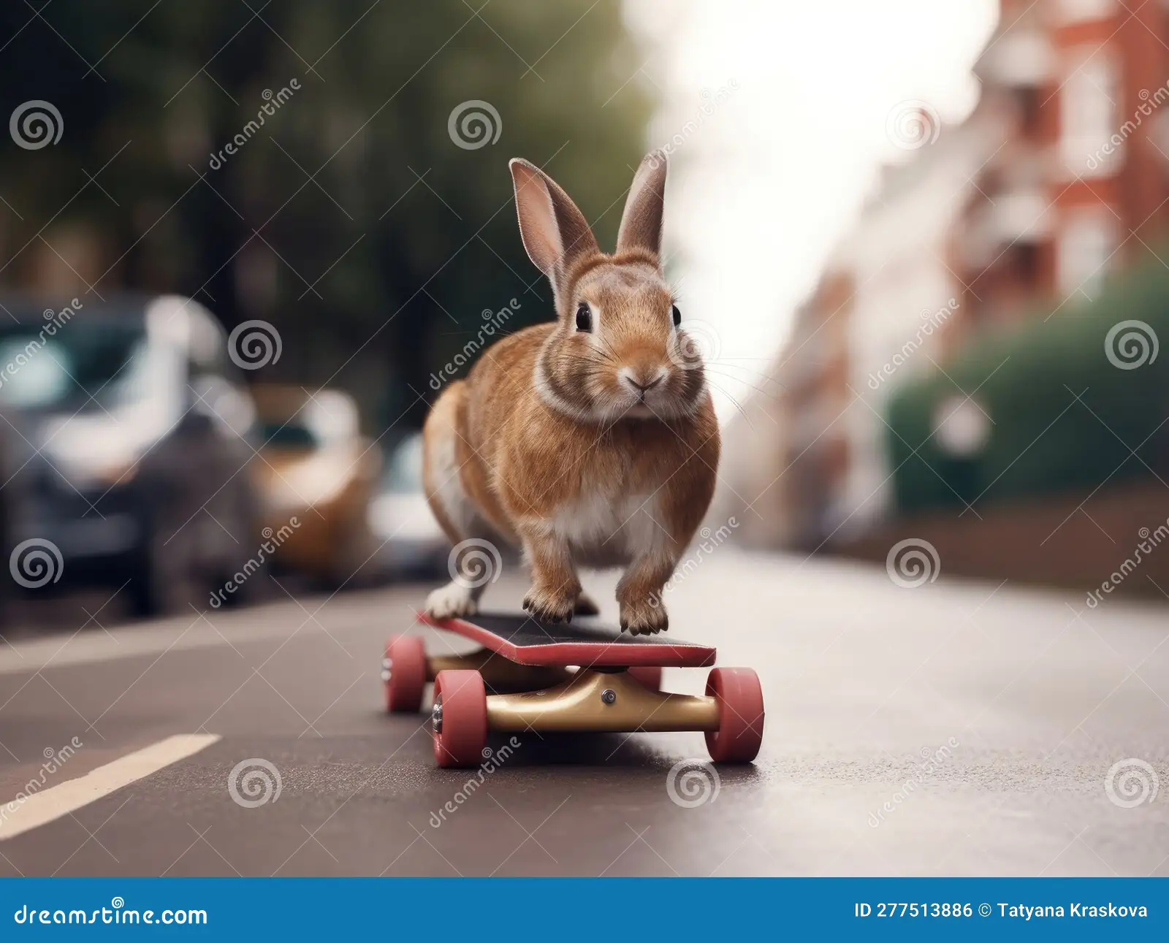
Let’s start with the basiscs…

Slide 29
Types of builds for our discussion
Developer Build Laptop + Hoodie
Interim Build
Static Build Server(s)
Production Build
….As much disposable infrastructure as possible.

Slide 30
Foundational Best Practices
Never
Never build your production version of any software on a machine with Outlook.
Never build your production version on a machine that has accessed the internet.
Never include ANYTHING in your production build that is not recorded in version control.

Slide 31
Foundational Best Practices
Do’s
Be able to prove that you know everything in your production build.
    Behave like you would be liable for not knowing.
    Because you “Probably” are. ☺
    *Chuck Anderson is not a lawyer. Double check with your own attorneys.

Slide 32
Foundational Best Practices
Do’s
Story Time about old hard drive…..

Slide 33
Foundational Best Practices
When you build your production build, create your build infrastructure from scratch, build your product, check everything* in, and then delete your build environment.
* build scripts, code, objects, containers/os**, dev tools, tests, dependencies, build logs, and software. (etc)

Slide 34
Foundational Best Practices
Do’s
Version Control
Best practices in code
2-3 check-in approvers
Delete your build environment after each production build
Automate your build environment creation
Check in your build log
Build your dependencies
Check in your dependencies* at prod build time

Slide 35
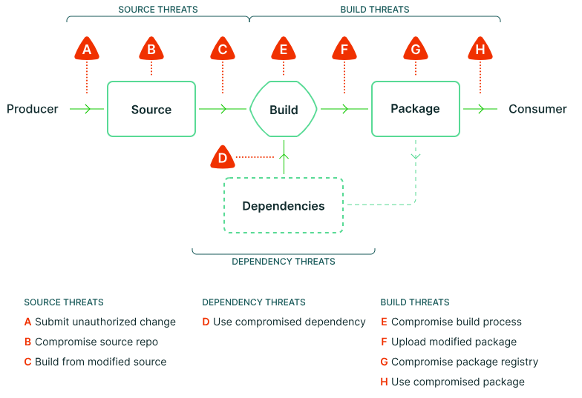
Some…. Types of build threats….
SLSA • Supply chain threats

Slide 36
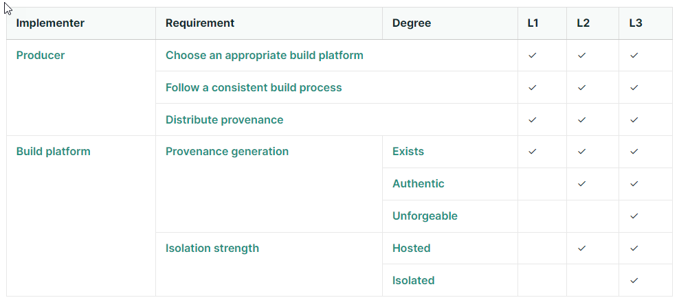
SLSA Levels
SLSA • Producing artifacts

Slide 37
How to – Example (Outdated?)
Git for Code
Jenkins for orchestration
Docker for building environments
Terraform to build containers
Hashi Vault for passwords, tickets, tokens

Slide 38
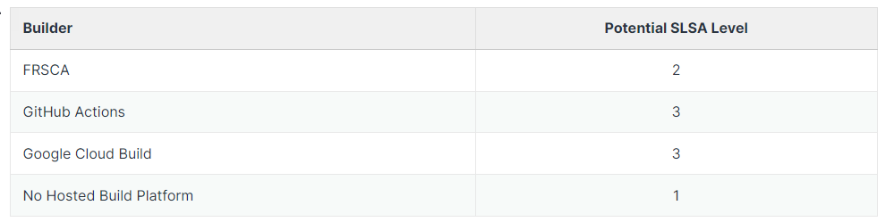
Types of builds for our discussion
SLSA • Producing artifacts

Slide 39
How to - Example #2 (Outdated?)
Github Actions
Just needs a yml file to build the server…

Slide 40
Show and Tell… slide style
The app doesn’t matter, its how you use it.

Slide 41
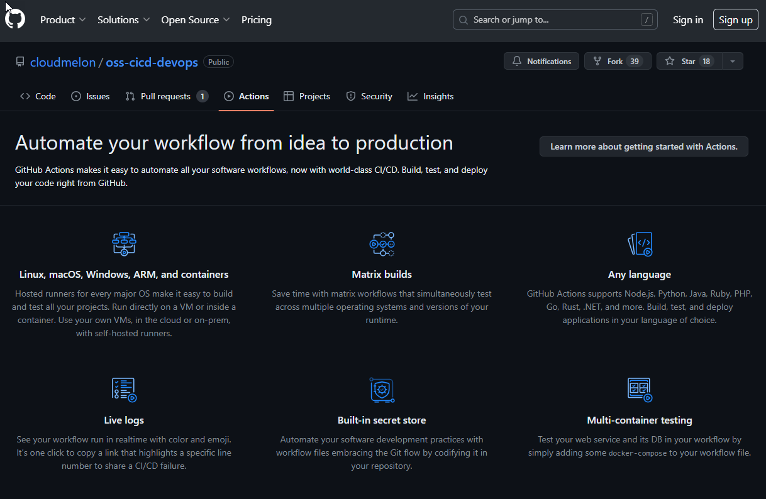

Slide 42
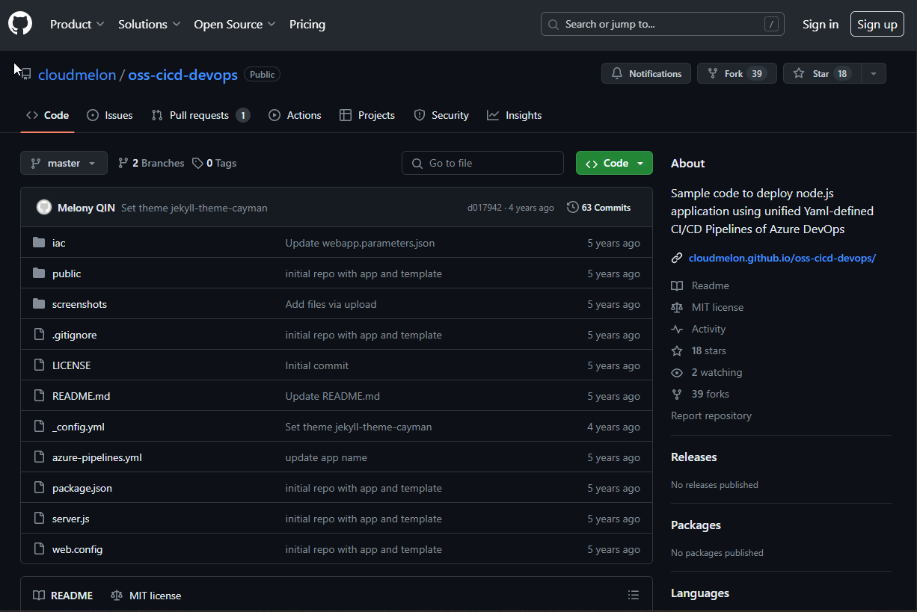

Slide 43
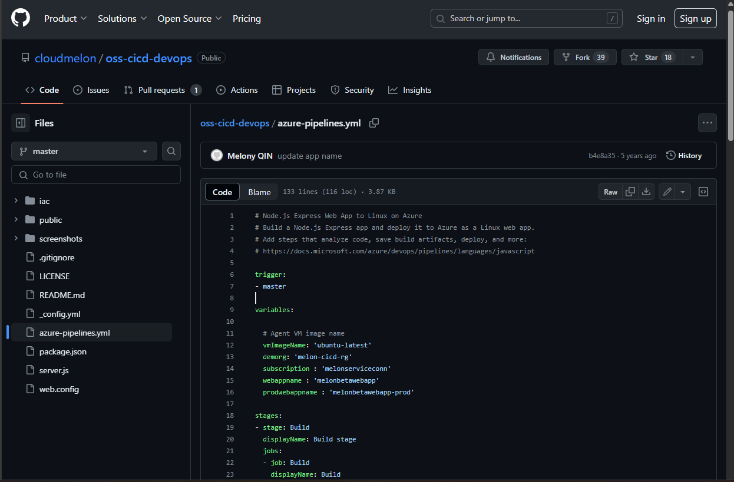

Slide 44
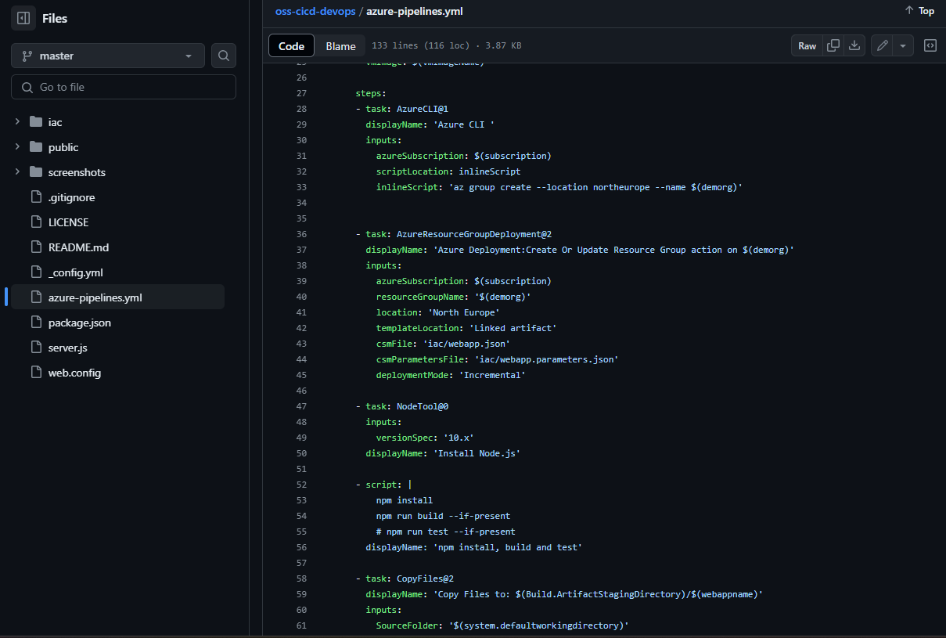
Start with a clean slate
Deploy build tools
Build your own dependencies
Check-in logs, code, and payloads
Teardown + regen Build Env
Build your app
Check it in
Test it
Check-in test results
Tear it down
Then promote it

Slide 45
Additional options and reading
(more than slsa.dev now….)
TACOS Framework · GitHub
Secure Software Development Framework | CSRC (nist.gov)
CIS Software Supply Chain Security Guide (cisecurity.org)
GitHub - ossf/scorecard: OpenSSF Scorecard - Security health metrics for Open Source

Slide 46
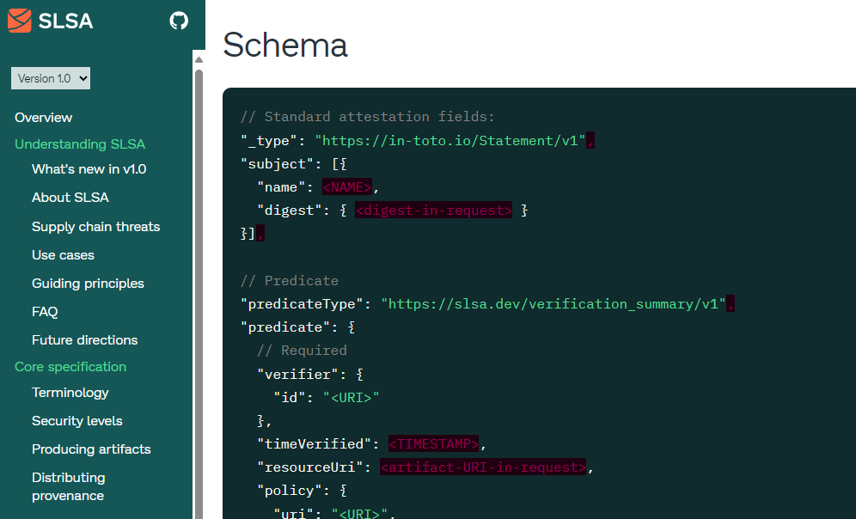

Slide 47

SLSA and
Build Environment Security – 5/2024
Chuck Anderson – Thank You!
Chuck@ReliantManagedServices.com
Slides available at: https://www.RelaintManagedServices.com

